Slide 1
Chapter 2

Slide 2
Objectives

Slide 3
Objectives (cont.)

Slide 4
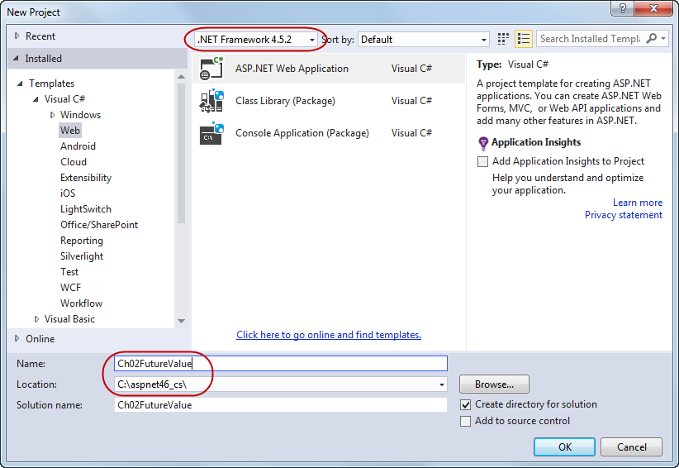
The New Project dialog box

Slide 5
How to start a new web application

Slide 6
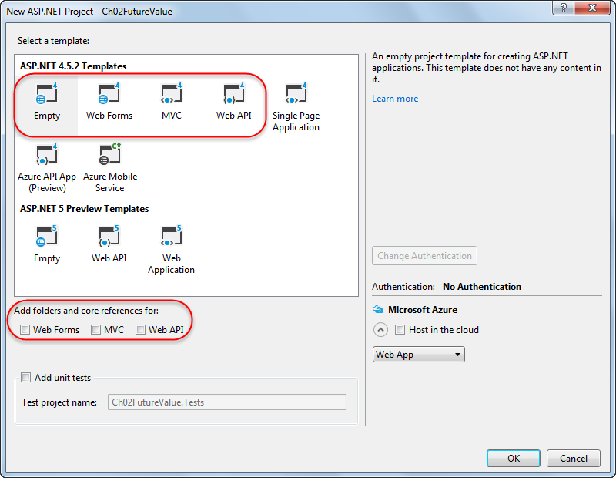
The New ASP.NET Project dialog box

Slide 7
The ASP.NET 4.5.2 / ASP.NET 4.6 templates you’ll use in this book

Slide 8
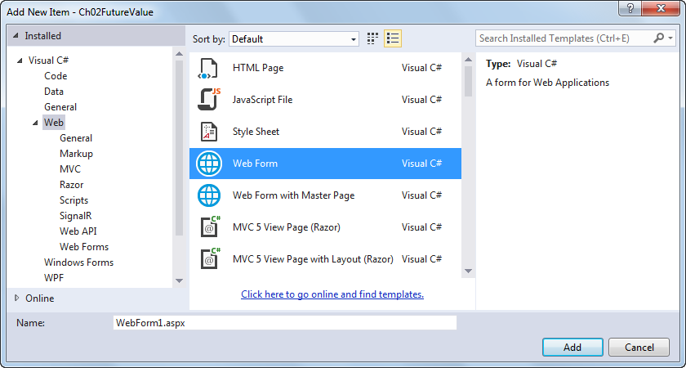
The Add New Item dialog box for adding a new web form

Slide 9
Two ways to open the Add New Item dialog box

Slide 10
How to add a new web form to a project

Slide 11
How to add an existing web form to a project

Slide 12
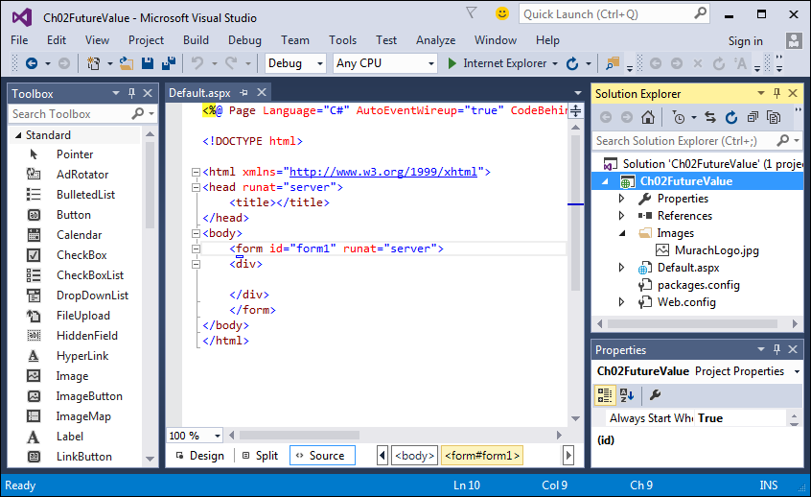
Visual Studio with the Designer in Source view and three other windows

Slide 13
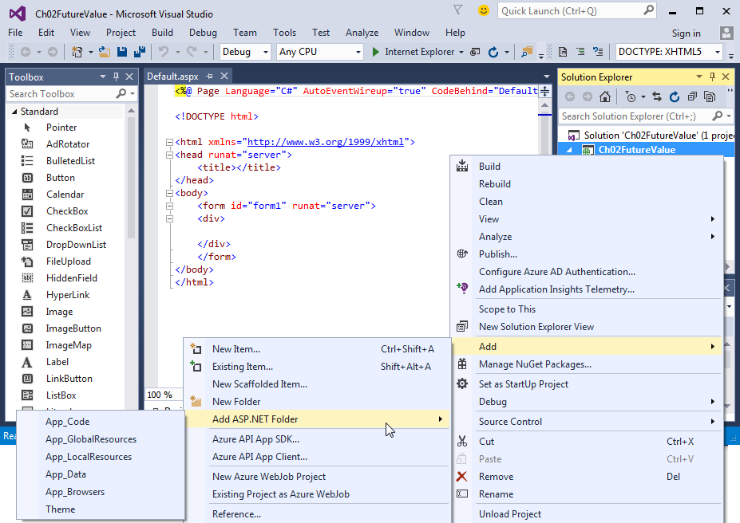
The Future Value project as a new folder is being added

Slide 14
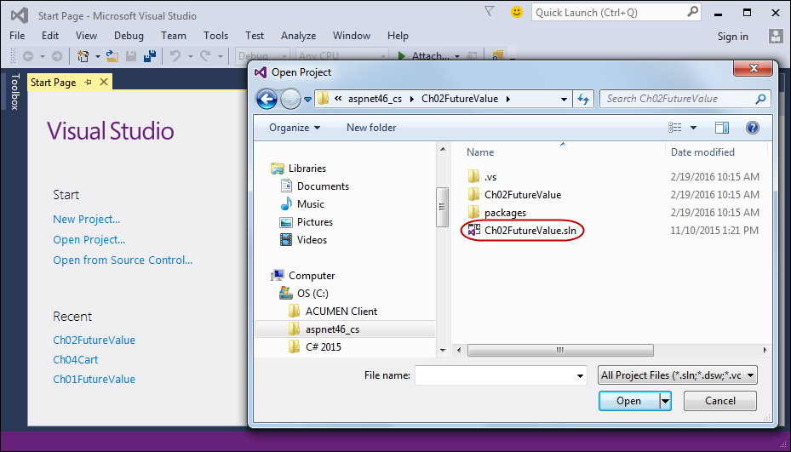
The Visual Studio Start Page and the Open Project dialog box

Slide 15
How to use the Open Project dialog box to open a web application

Slide 16
Other ways to open a web application

Slide 17
How to work with the Start Page

Slide 18
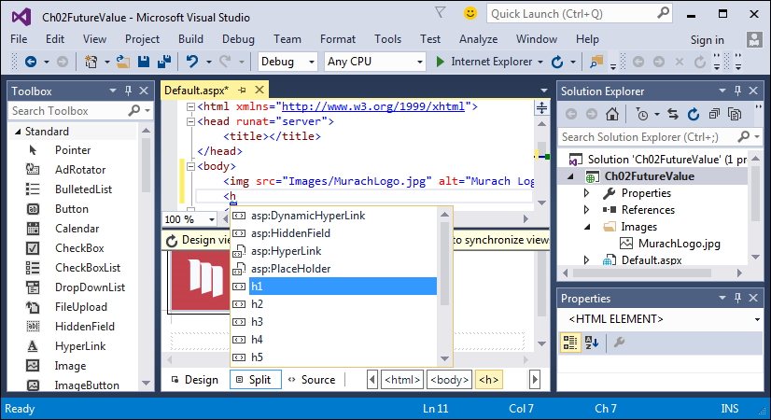
The Future Value form in Split view after an img element has been added

Slide 19
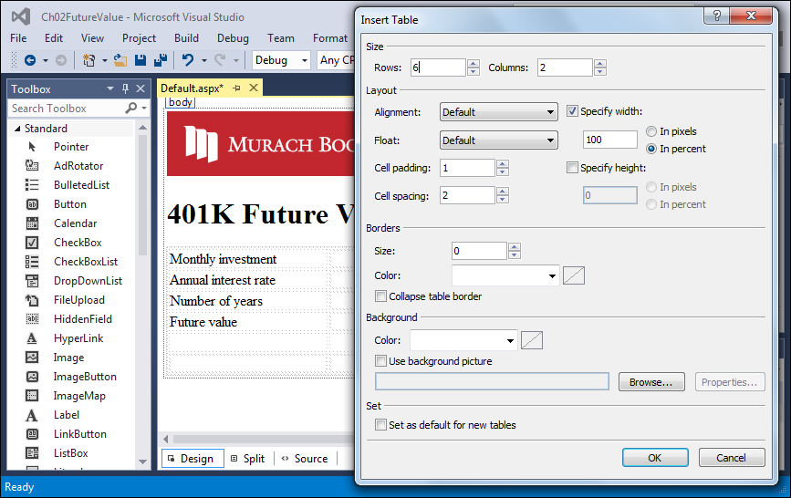
The Future Value form with a table that has been inserted into it

Slide 20
How to add a table to a form

Slide 21
How to format a table after it has been added to a form

Slide 22
How to add text to a table and format it

Slide 23
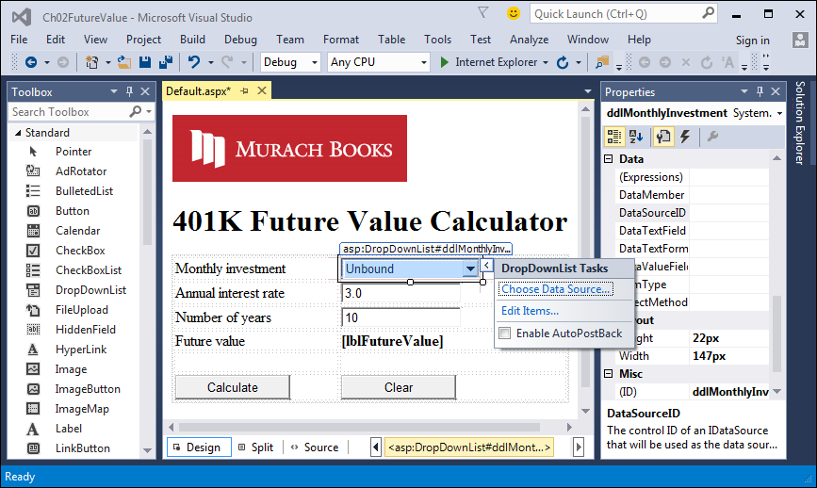
The Future Value form after six server controls have been added to it

Slide 24
How to add a web server control to a web form

Slide 25
How to set the properties for a control

Slide 26
Common web server control properties

Slide 27
Common properties of drop-down list and list box controls

Slide 28
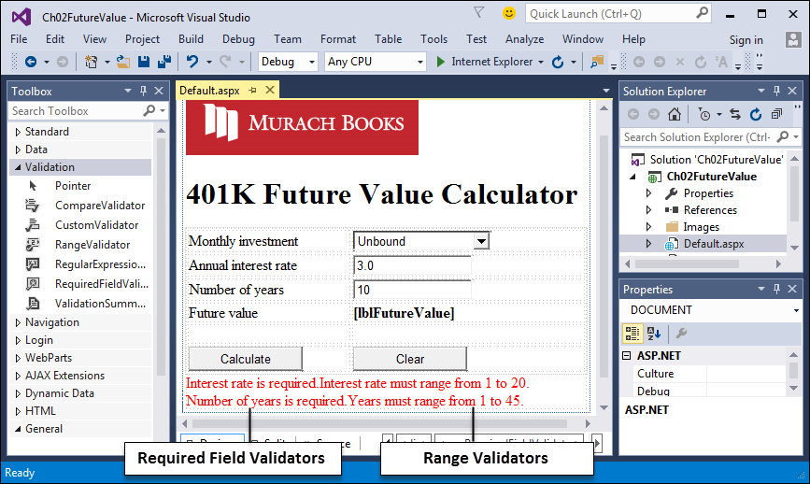
The validation controls on the Future Value form

Slide 29
How to add a validator to a web form

Slide 30
How to set the properties for a validation control

Slide 31
Common validation control properties

Slide 32
The aspx for a RequiredFieldValidator control

Slide 33
The aspx code for a RangeValidator control

Slide 34
Two values for the UnobtrusiveValidationMode setting

Slide 35
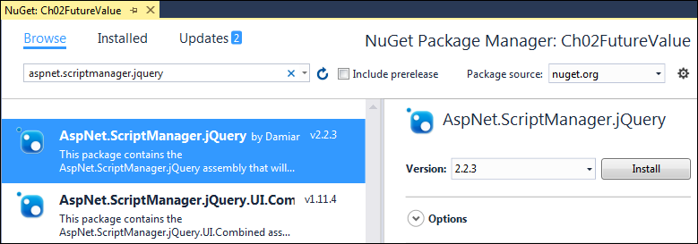
The NuGet Package Manager page

Slide 36
How to install the NuGet package for jQuery validation

Slide 37
A Load event handler that turns off unobtrusive validation for a page

Slide 38
A Web.config setting that turns off unobtrusive validation for an application

Slide 39
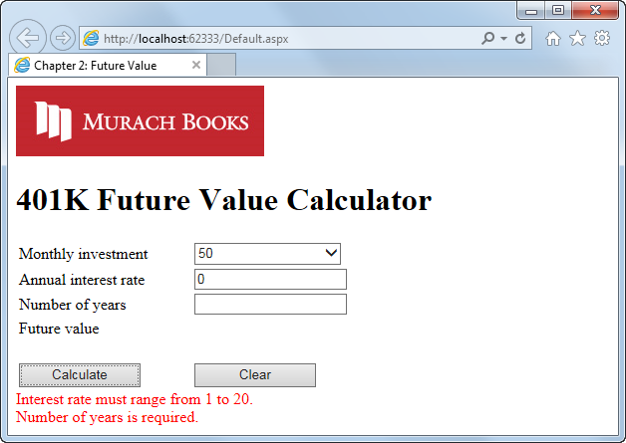
The design of the Future Value form

Slide 40
The aspx code for the Future Value form

Slide 41
The aspx code for the Future Value form (cont.)

Slide 42
The aspx code for the Future Value form (cont.)

Slide 43
The aspx code for the Future Value form (cont.)

Slide 44
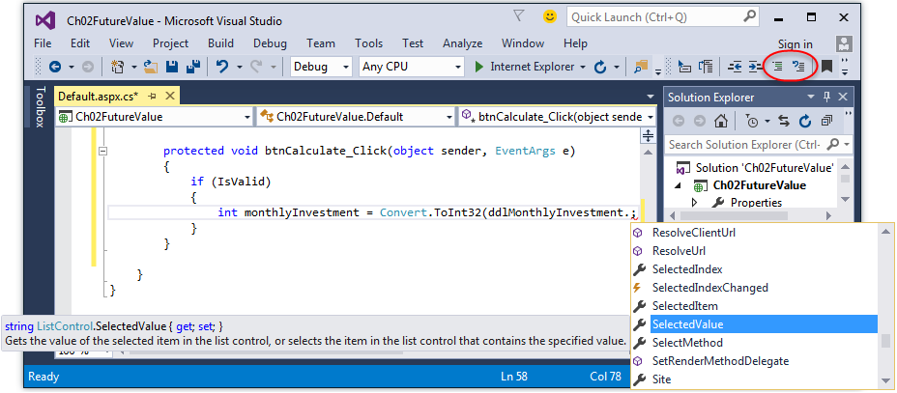
The Code Editor for a web form

Slide 45
Two ways to start an event handler

Slide 46
How to insert a code snippet

Slide 47
How to use the Quick Actions light bulb feature

Slide 48
How to comment out a portion of code

Slide 49
Common ASP.NET page events

Slide 50
Common ASP.NET control events

Slide 51
Code for the Click event of the btnClear button

Slide 52
The C# code for the Future Value form

Slide 53
The C# code for the Future Value form (cont.)

Slide 54
The C# code for the Future Value form (cont.)

Slide 55
The C# code for the Future Value form (cont.)

Slide 56
How to run an application

Slide 57
How to stop an application

Slide 58
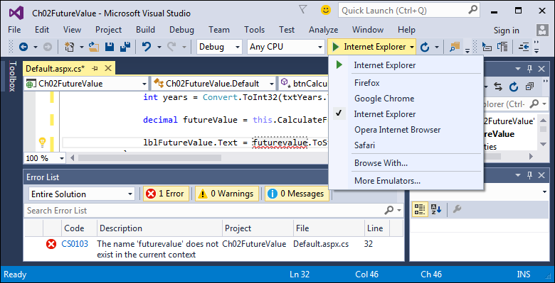
Visual Studio with the Error List window and browser list displayed

Slide 59
How to fix syntax errors and exceptions

Slide 60
Two ways to view the HTML for a page in a browser

Slide 61
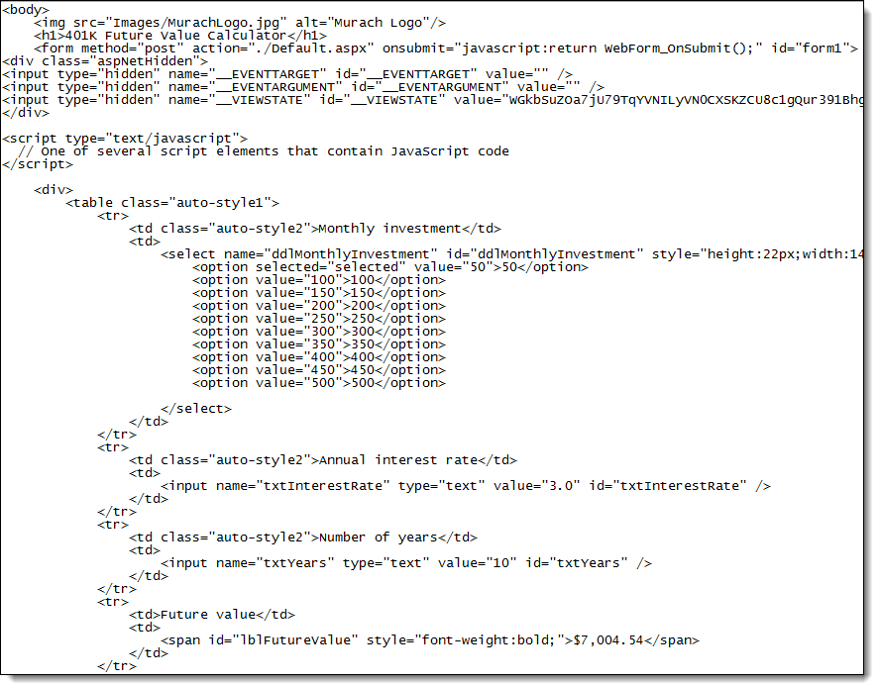
Some of the HTML for the Future Value form

Slide 62
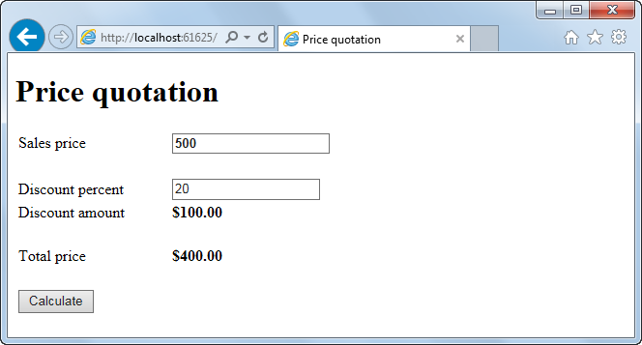
Extra 2-1 Build the Quotation application

